Slide 1
Gordon Earle Moore (born January 3, 1929)
co-founder and chairman emeritus of Intel Corporation,
and the author of Moore's law.

Slide 2
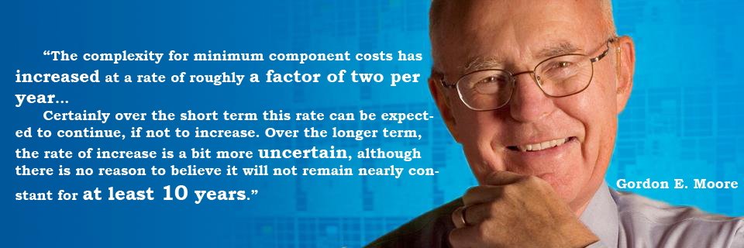

Can’t imagine the life without it…
Moore's law:
SO THANKS FOR Moore's law!

